Slide 1
OGTIP Internship Project: Python
EDA - Exploratory Data Analysis for Loan Default Risk Prediction
Ramya Panchatcharam
15/09/2024

Slide 2
Table of contents
01
Introduction
02
About the Dataset
03
04
Risk Analytics
EDA- Exploratory Data Analysis
Describe the project focus, Objective and outcome
Describe the Source, Features and purpose
Describe the Feature Importance, Decision Making, Financial Risk Management
Explain the EDA steps, including data loading and analyses like univariate and bivariate
06
Present Findings
05
Merge Two Datasets
Summarize key insights and patterns from EDA and use visualizations to communicate the data insights effectively.
Explain the Merged Dataset EDA like heatmap, analysis contract type and status

Slide 3

Introduction
Project Focus : Apply Exploratory Data Analysis (EDA) to identify patterns predicting loan repayment difficulties.
Objective: Minimize lending risk by identifying factors indicating loan default likelihood.
Outcome: Assist in loan approval decisions based on repayment likelihood.

Slide 4
Objective
EDA Techniques: Identify key factors behind loan defaults.
Goal: Enhance risk assessment to approve applicants with higher repayment potential.
Project Approach
Identify Key Variables: Predictive of loan defaults.
Data Cleaning: Ensure reliable and accurate analysis.
Explore Relationships: Find indicators of default risk.
Summarize Findings: Provide actionable insights for risk management.

Slide 5
About the Dataset
Source
Loan records from a financial institution. Main File: Previous_application, application_data, and Column Description
Features
Purpose
Client profiles, payment history, loan amounts, interest rates, etc.,
Understand borrower characteristics and create effective risk mitigation strategies.

Slide 6
Key Concepts and Challenges
Exploratory Data Analysis (EDA):
Risk Analytics:
Data Preprocessing
Decision-Making
Assess variables affecting loan default risk.
Discover patterns in data.
Use data-driven insights to inform lending decisions.
Clean and transform data for accurate results.
Financial Risk Management:
Use analysis to minimize default risk.

Slide 7
EDA - Exploratory Data Analysis

Slide 8
Steps for EDA - Overview
Import Libraries | Multivariate Analysis
Load Data | Outlier Detection
Initial Data Exploration | Data Distribution
Handle Missing Values | Relationship Between Days-Based Variables and Risk
Univariate Analysis | Data Quality Checks
Bivariate Analysis | Check Target Value for Imbalance
Time-Based Analysis | Risk Analytics
Target Variable Analysis | Merge Datasets

Slide 9
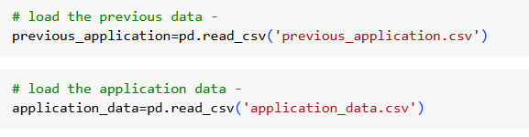
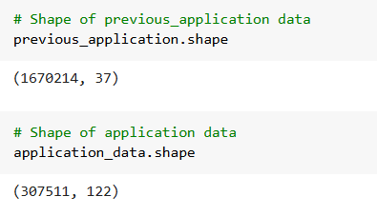
Import Libraries
Steps for EDA
Import key libraries: pandas, numpy, matplotlib, seaborn, etc
Load Data
Load datasets into Pandas DataFrame for analysis.
Shape of Data
Size of the data find using the shape method

Slide 10
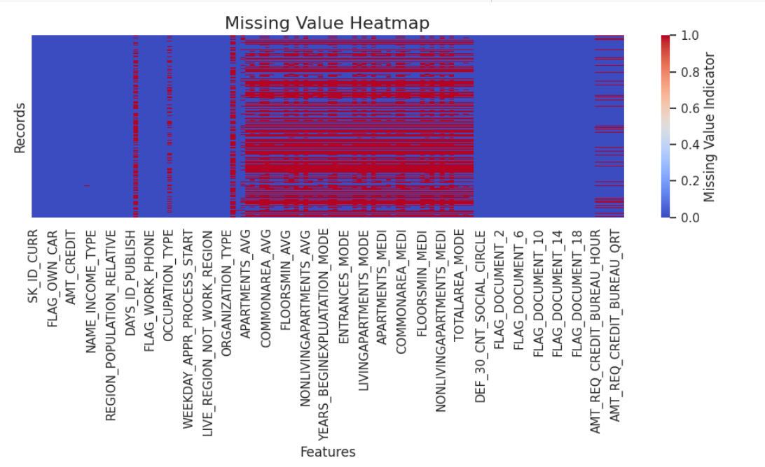
Steps for EDA - Handling Missing Values
Identify missing data using isnull().sum().
Treat missing values with techniques like fillna(), dropna(), or imputation.
Use a seaborn heatmap to visualize missing values in application_data, with red indicating high missingness and blue showing complete columns.

Slide 11
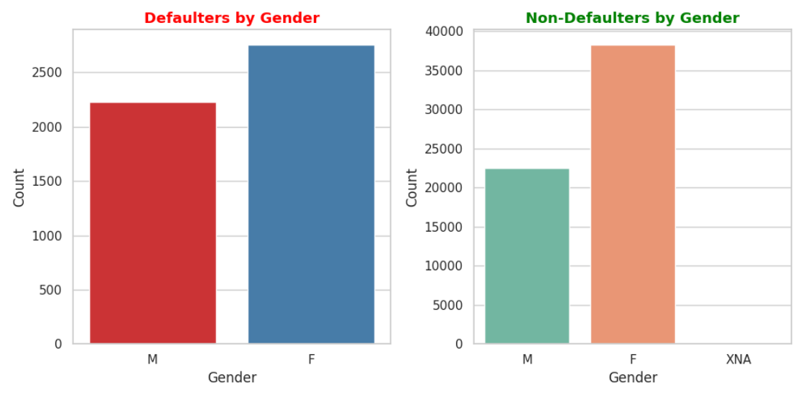
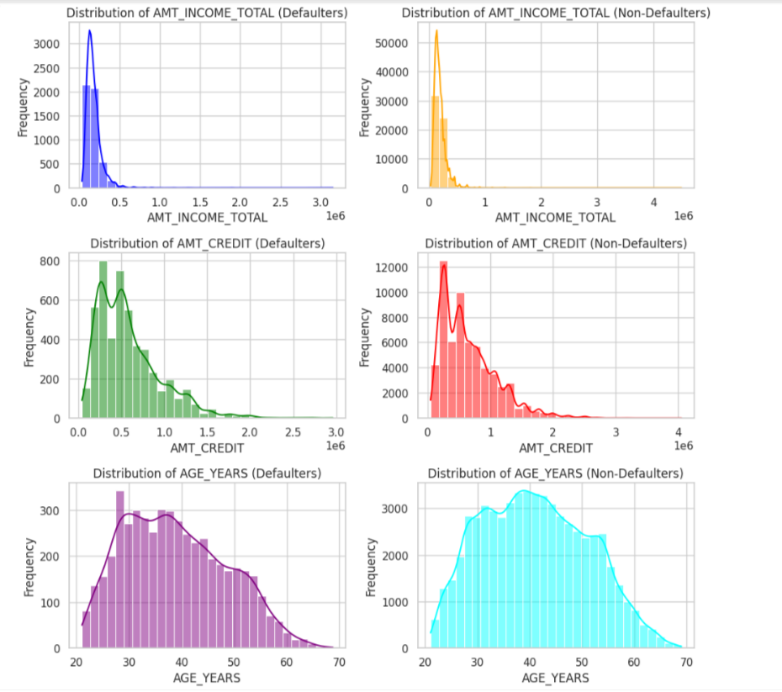
Steps for EDA - Univariate Analysis
1. Analyzing how loan repayment is affected by Gender: Defaulters vs. Non-Defaulters
2. Visualizing the Distribution of Numerical Features
Females have a higher default rate but also more non-defaulters.
The "XNA" category for missing gender data is significant, indicating incomplete information.
Income level and loan amount are key factors in predicting loan default, but age shows no clear distinction.
Further analysis is needed to understand age's interaction with income and credit history.
For a deeper analysis, refer to the notebook.

Slide 12
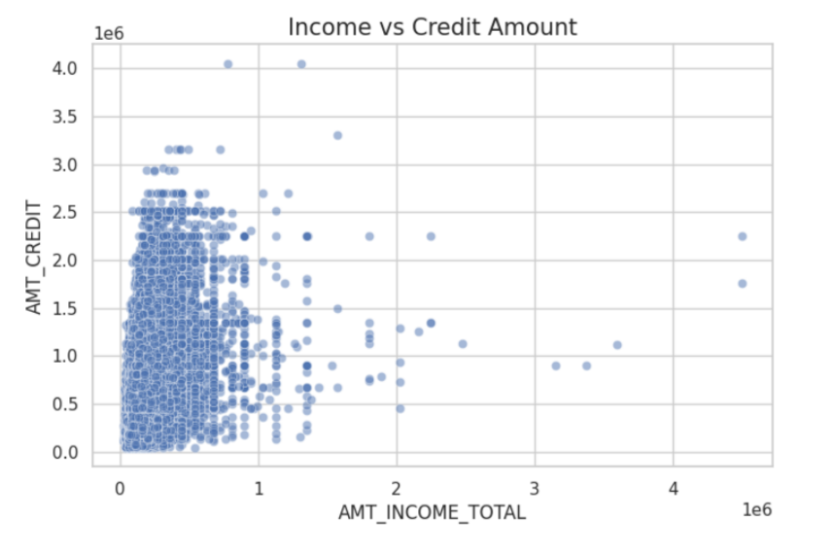
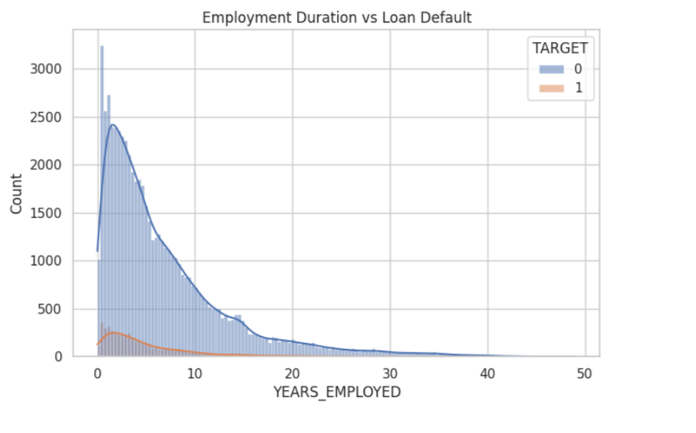
Steps for EDA - Bivariate Analysis
1. Visualizing Relationships Between variables in application_data file
2. Relationship Between DAYS_EMPLOYED and Loan Default (TARGET)
There is a positive trend, other factors likely affect the relationship between income and credit amount.
longer employment durations seem to reduce default risk, but further analysis is needed for deeper insights.
For a deeper analysis, refer to the notebook.

Slide 13
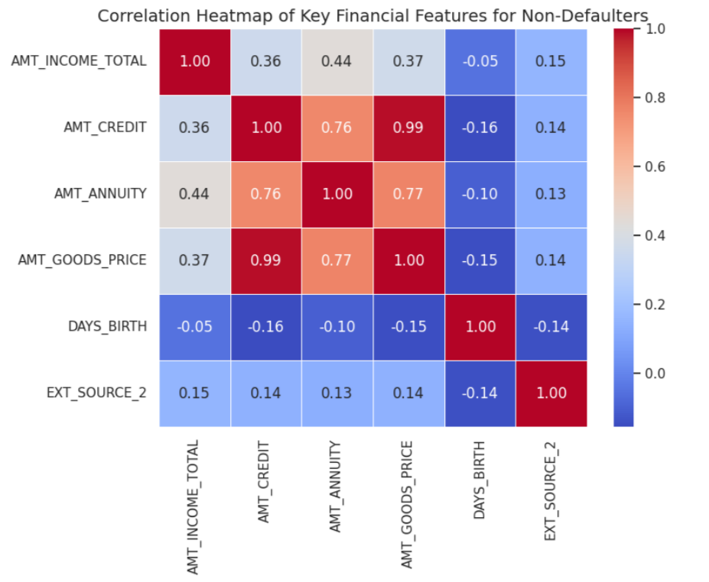
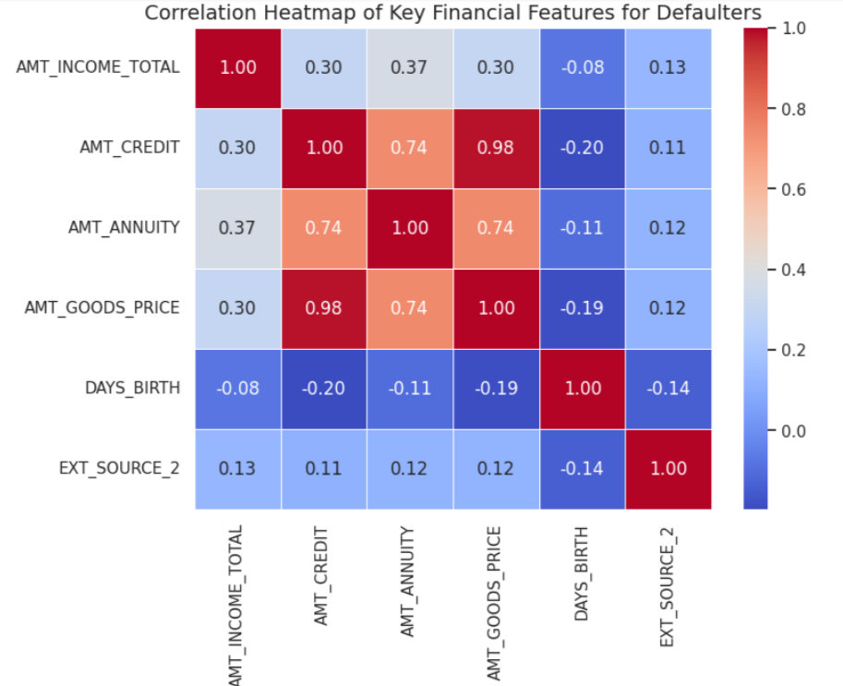
Steps for EDA - Bivariate Analysis
3. Correlation Heatmap of Key Financial Features for Non-Defaulters
4. Correlation Heatmap of Key Financial Features for Defaulters
The heatmaps shows strong links between AMT_CREDIT, AMT_ANNUITY, and AMT_GOODS_PRICE. AMT_INCOME_TOTAL is moderately correlated with AMT_CREDIT. DAYS_BIRTH and EXT_SOURCE_2 show weak relationships with financial features in both (Non-defaulters and defaulters)

Slide 14
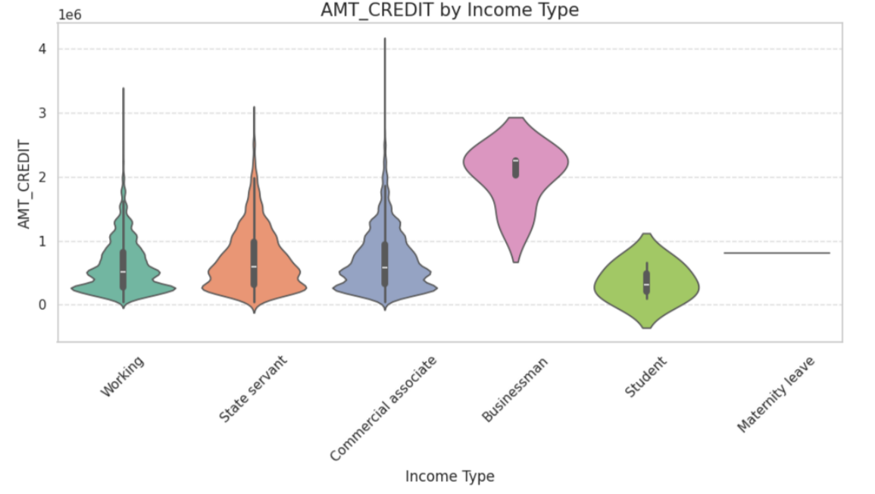
Steps for EDA - Bivariate Analysis
5. Violin Plot for AMT_CREDIT by NAME_INCOME_TYPE in application_data
Income type is a key factor in credit amount distribution, influencing credit profiles and risk assessment.

Slide 15
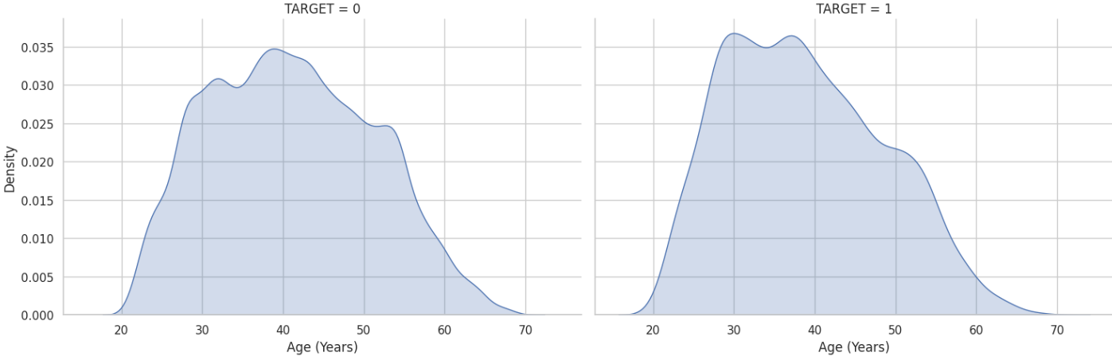
Steps for EDA - Time-Based Analysis
1. Compare the distribution of AGE_YEARS and YEARS_EMPLOYED for defaulters vs. non-defaulters.
This visualization provides a comparative view of how age varies between the two target groups, helping to identify any potential age-related patterns in loan default behavior.

Slide 16
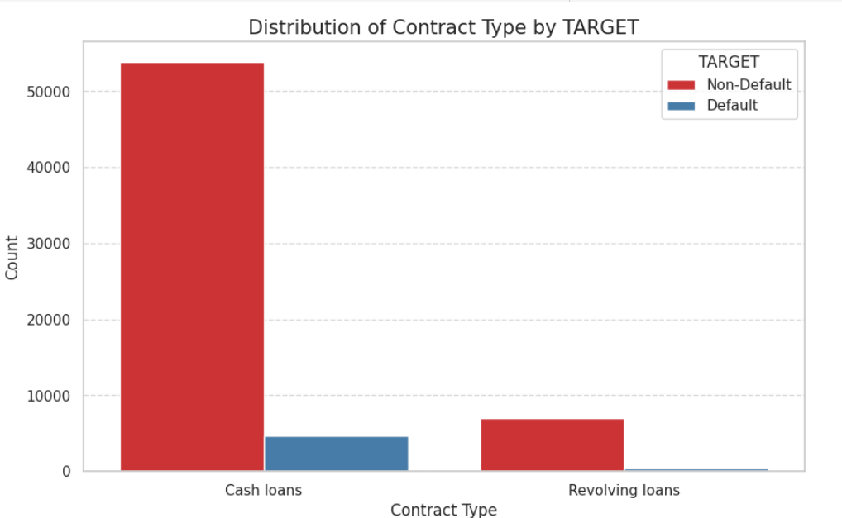
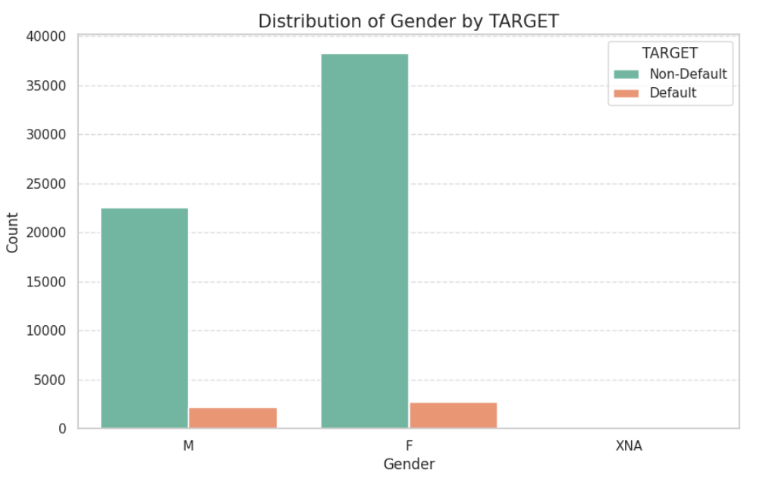
Steps for EDA - Target Variable Analysis
1. Distribution of Contract Type by TARGET in application_data
2. Distribution of Gender by TARGET in application_data
The chart shows cash loans are the most common contract type at TARGET, with most individuals holding cash and revolving loans not classified as "Default."
The chart shows that TARGET has more female employees than male employees.

Slide 17
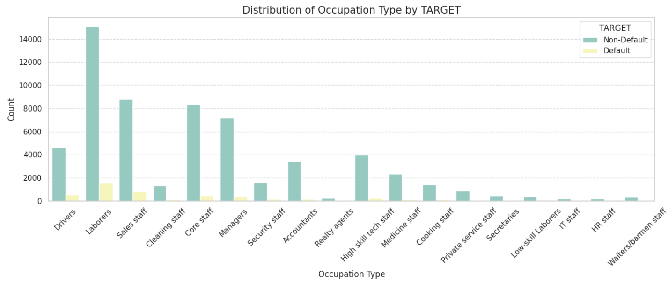
Steps for EDA - Target Variable Analysis
3. Distribution of Occupation Type by TARGET in application data
The chart shows the distribution of occupation types by TARGET, which is likely a company or organization.
It shows that drivers, laborers, and sales staff are the most common occupations.

Slide 18
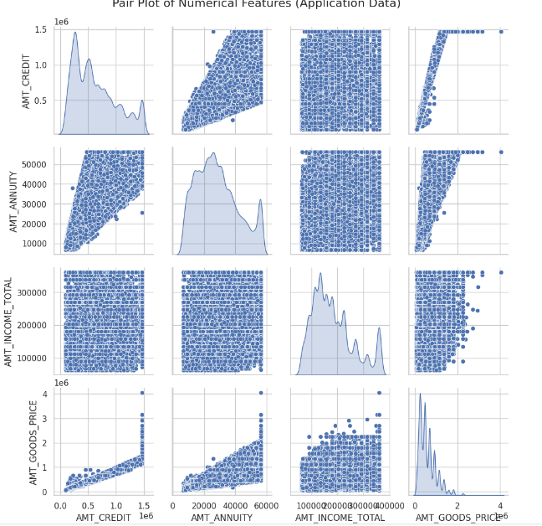
Steps for EDA - Multivariate Analysis
1. Distribution of Occupation Type by TARGET in application data
The chart shows the distribution of occupation types by TARGET, which is likely a company or organization.
The pair plot reveals significant correlations, distributions, and outliers among the features.
Distributions: Right-skewed distributions for income and credit amounts.

Slide 19
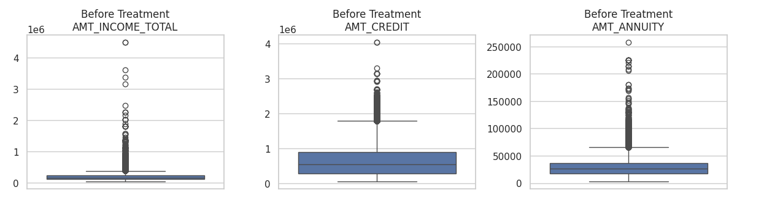
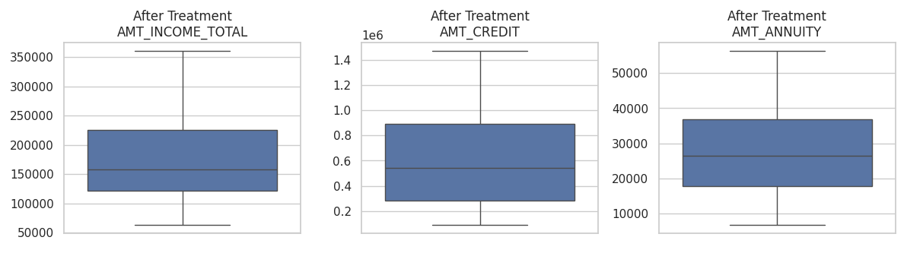
Steps for EDA - Outlier Detection
1. To Detect Outliers in the Application_data and Decide on Their Treatment
Using Caps outliers in a DataFrame using a specified percentile-based approach. It then visualizes the distribution of the data after outlier treatment using box plots.

Slide 20
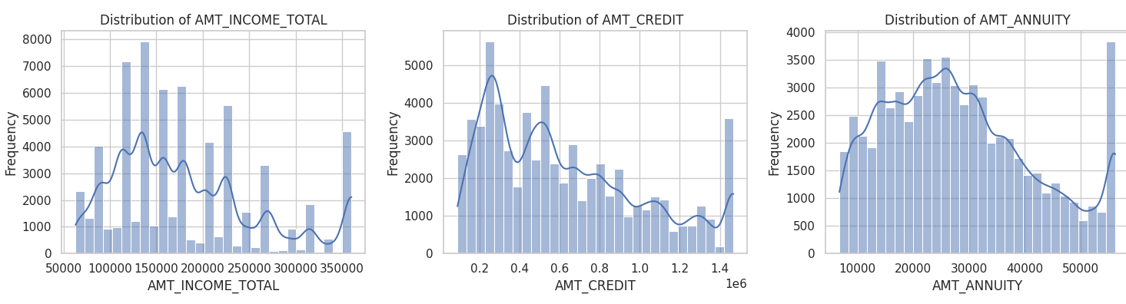
Steps for EDA - Data Distribution
1. Distribution Analysis of Key Numerical Features
The distributions of all three variables exhibit right-skewness, indicating that a majority of individuals have lower values for these financial metrics, while a smaller number have higher values.
This suggests that there is a significant disparity in income, credit, and annuity payments among the individuals in the dataset.

Slide 21
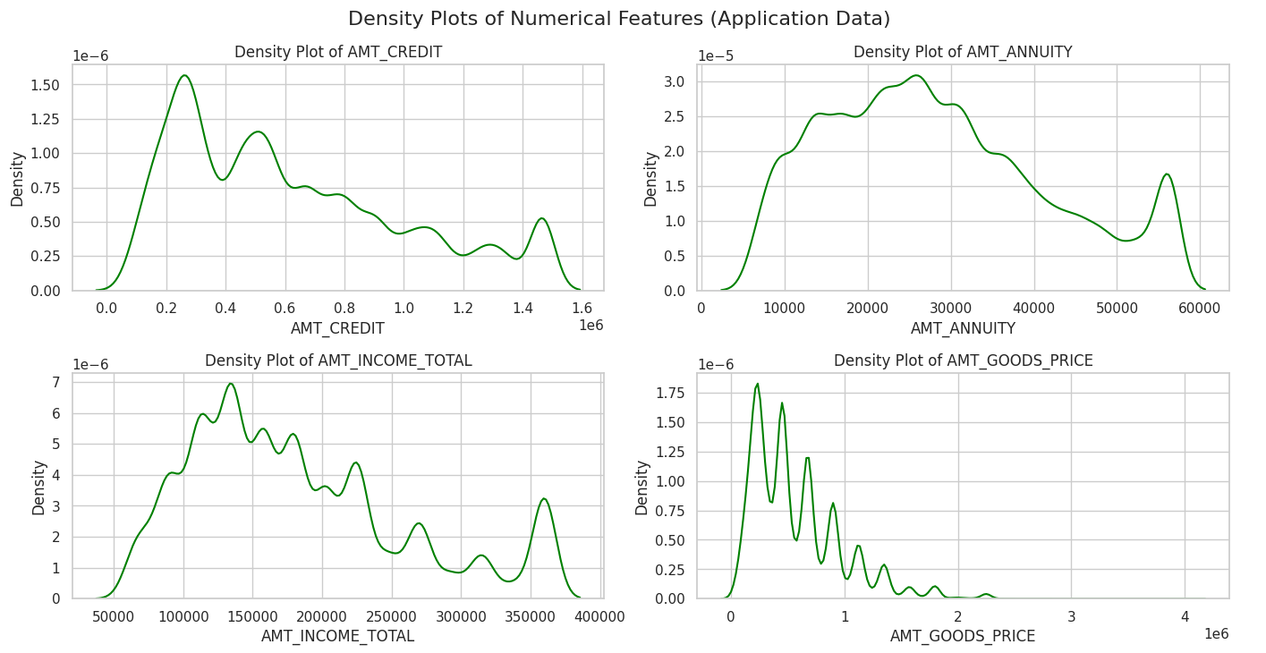
Steps for EDA - Data Distribution
2. Density Plots of Numerical Features in Application Data
The density plots provide valuable insights into the distribution of the numerical features in the application data. They help identify the shape, skewness, and potential outliers in the data.

Slide 22
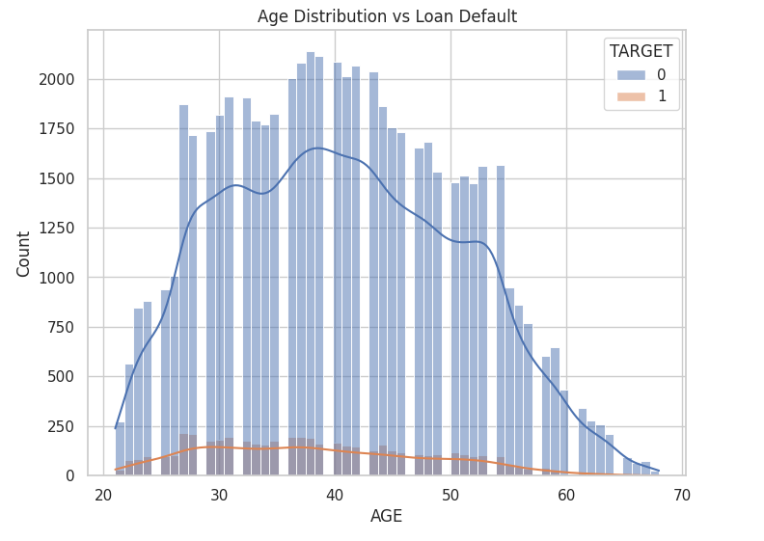
Steps for EDA - Detecting Relationships
1. Detecting Relationships between Days-Based Variables and Risk
Relationship between age and loan default, with younger individuals being more likely to default on loans compared to older individuals.
However, it's important to note that other factors may also influence loan default, and further analysis would be needed to draw definitive conclusions.

Slide 23
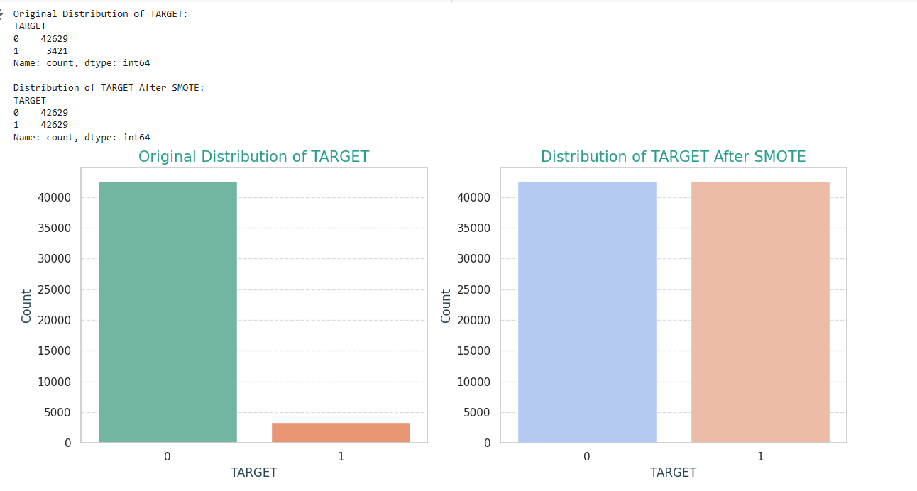
Steps for EDA – Imbalance Check
1. Check the Target Value if it is imbalanced
Using the SMOTE method to address the imbalance in the target value, the distribution is adjusted to 0: 47,626 and 1: 42,629. Before applying SMOTE, the distribution was 0: 42,629 and 1: 3,421.

Slide 24
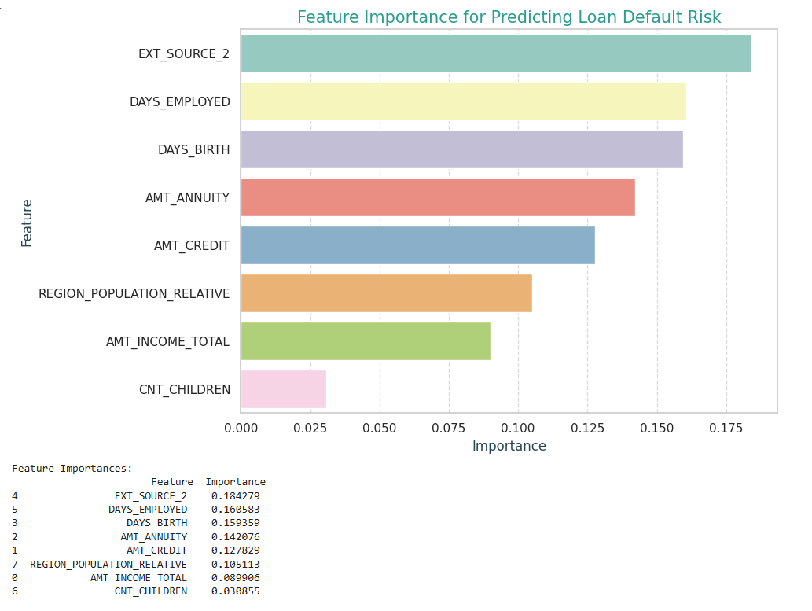
Steps for EDA - Risk Analytics
1. Feature importance using a RandomForeestClassifier model
EXT_SOURCE_2 and DAYS_EMPLOYED are the most influential features in predicting loan defaults.
AMT_ANNUITY and AMT_CREDIT also significantly impact default risk.
CNT_CHILDREN has the least impact among the top features.
These insights help prioritize which features to focus on for risk management and model improvement.

Slide 25
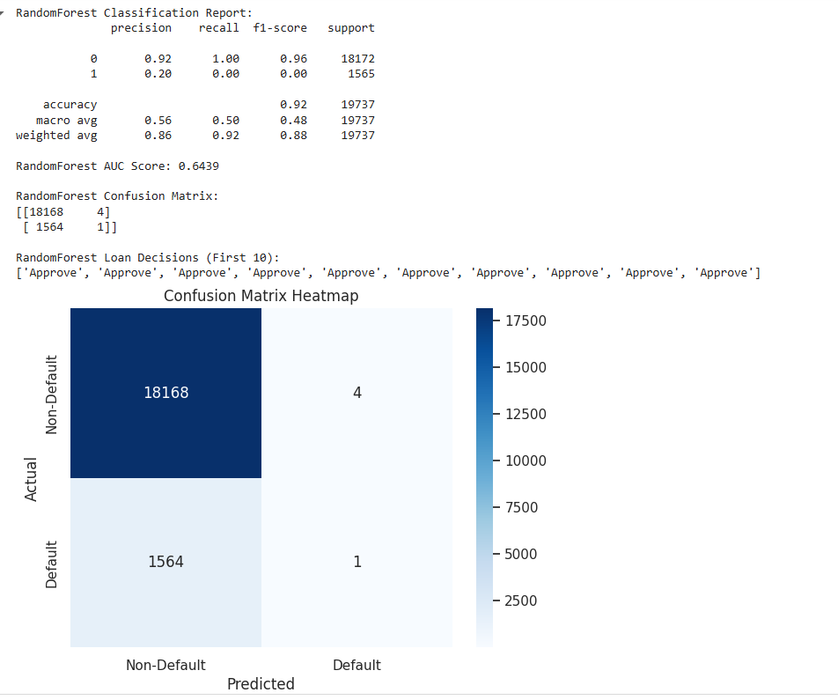
Steps for EDA - Decision Making
The results suggest that the Random Forest model is performing well in predicting the "Non-Default" class, with high precision and recall.
However, it struggles to predict the "Default" class, as indicated by the low precision and recall for this class.

Slide 26
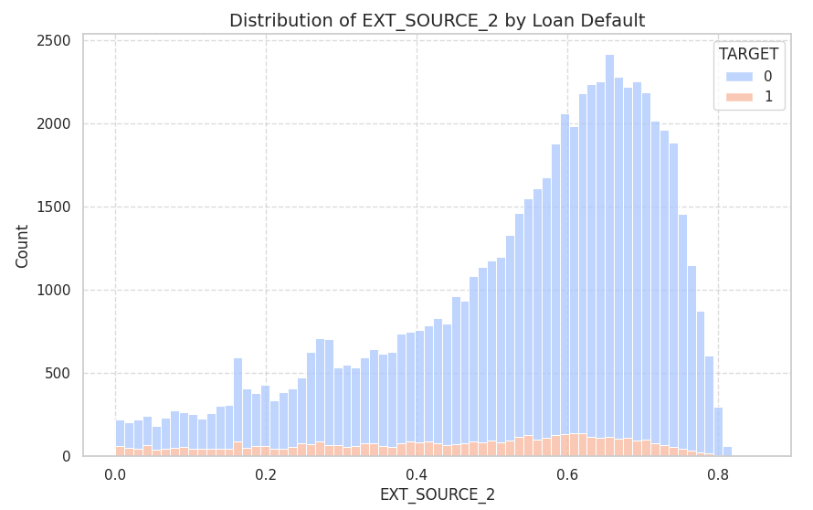
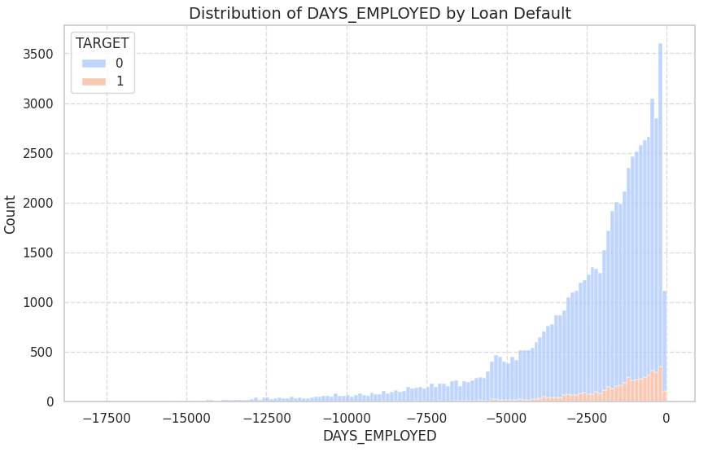
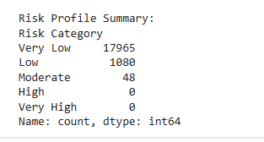
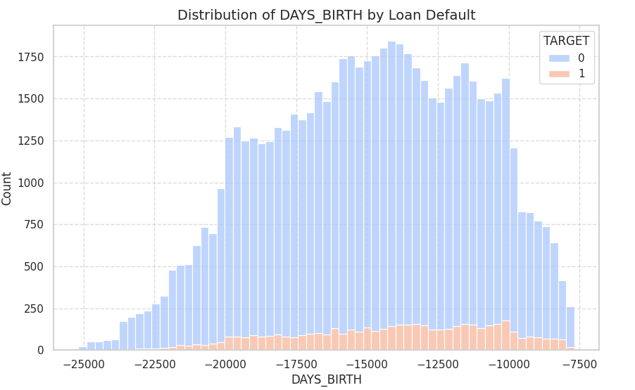
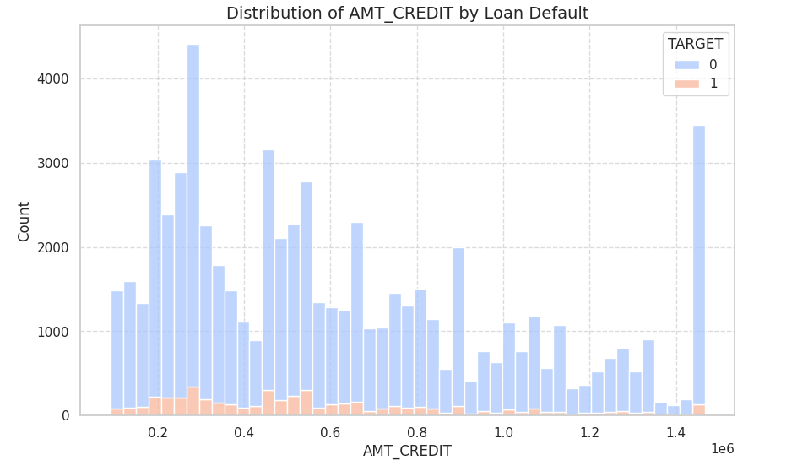
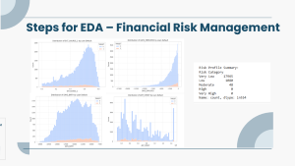
Steps for EDA – Financial Risk Management

Slide 27
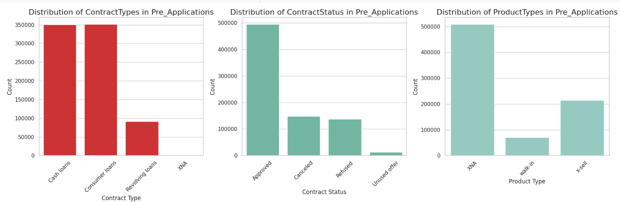
Steps for EDA - Merge Two dataset

Slide 28
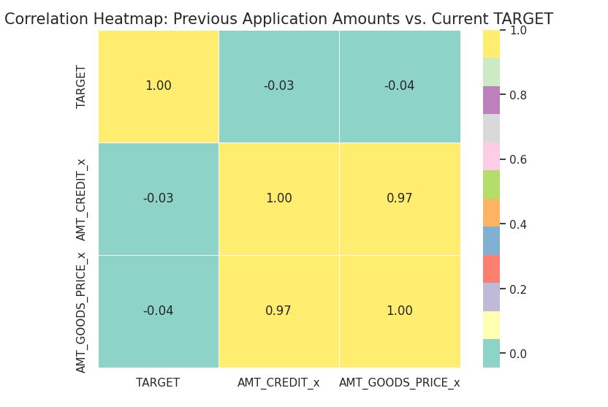
Steps for EDA - Risk Analytics
Heatmap of Previous Application Amounts vs. Current TARGET
The heatmap reveals a strong positive relationship between TARGET and AMT_CREDIT_X, while the relationship between TARGET and AMT_GOODS_PRICE_X is weak and negative.
Additionally, AMT_CREDIT_X and AMT_GOODS_PRICE_X are strongly positively correlated.

Slide 29
Present Findings
Correlation Between Features: Strong links between AMT_CREDIT, AMT_ANNUITY, and AMT_GOODS_PRICE.
Age vs Loan Default: Younger applicants tend to default more, with additional factors influencing risk.
Numerical Distributions: Income, credit, and annuity levels show right-skewed distributions.
Target Imbalance: SMOTE balanced target values from (Non-Default: 42,629, Default: 3,421) to equal numbers.
Risk Analytics: EXT_SOURCE_2 and DAYS_EMPLOYED are key predictors, though the model is more accurate with non-defaults (AUC: 0.6439).
Financial Risk: Most applicants are categorized as very low to low risk.
For a deeper analysis, refer to the notebook.

Slide 30
Conclusion
The EDA revealed key factors influencing loan default, including strong correlations between financial variables and a higher default likelihood among younger individuals.
Imbalance in the dataset was corrected using SMOTE, and risk analytics highlighted EXT_SOURCE_2 and DAYS_EMPLOYED as key predictors. While the model performed well for non-defaults, it requires improvement in detecting defaults. These insights will aid in better loan approval decisions and risk management.
For a deeper analysis, refer to the notebook.

Slide 31
Thanks!
Any questions?
samramya@gmail.com

